Slide 1
Unit 3
Context Free Grammer(CFG)
Prof. Deepali D. Ahir

Slide 2
Ways of representing language:
FA
RE
What if the language is not regualr?
Every grammer generates a language, a word of a language is generated by applying productions finite number of times.
Grammer can be used to represent both Regular and non regular languages.

Slide 3
A context-free grammar G is a quadruple (V, T, P, S) where
V/N is a set of variables/nonterminal.
Denoted by capital letters A,B,C...
T is a set of terminals.
Denoted by lower case letters a,b,c... or digit 0,1,2...
P is a set of production
P : V_{i}--> α_{i} where α_{i} is a string of terminals and non terminals
S is the start symbol.
Start symbol is used to derive the string

Slide 4
Example:
S → a
S → aS
S → bS
Or
S → a | aS | bS

Slide 5
Derivations
A derivation of a string for a grammar is a sequence of grammar rule applications that transform the start symbol into the string.
A derivation proves that the string belongs to the grammar's language.
A derivation is represented by :
Sentential form(leftmost, rightmost)
Parse tree form
Final string should consist of terminals
In left sentential form, leftmost symbol is picked up for the expansion
In right sentential form, rightmost symbol is picked up for the expansion

Slide 6
Sentential form
For instance, with the grammar:
S → S + S ......1
S → 1 .......2
S → a ......3
the string 1 + 1 + a can be derived from the start symbol S with the following derivation:
S→ S + S (by rule 1. on S)
→ S + S + S (by rule 1. on the second S)
→ 1 + S + S (by rule 2. on the first S)
→ 1 + 1 + S (by rule 2. on the second S)
→ 1 + 1 + a (by rule 3. on the third S)

Slide 7
leftmost derivation
S → S + S .......1
S → 1 .......2
S → a ......3
________________________________________________________
S
→ S + S (by rule 1 on the leftmost S)
→ 1 + S (by rule 2 on the leftmost S)
→ 1 + S + S (by rule 1 on the leftmost S)
→ 1 + 1 + S (by rule 2 on the leftmost S)
→ 1 + 1 + a (by rule 3 on the leftmost S),

Slide 8
Rightmost derivation
S → S + S .......1
S → 1 .......2
S → a ......3
________________________________________________________
S
→ S + S (by rule 1 on the rightmost S)
→ S + S + S (by rule 1 on the rightmost S)
→ S + S + a (by rule 3 on the rightmost S)
→ S + 1 + a (by rule 2 on the rightmost S)
→ 1 + 1 + a (by rule 2 on the rightmost S)

Slide 9
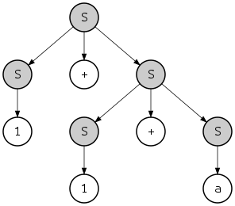
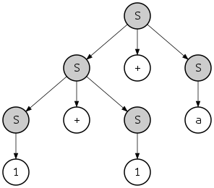
Parse tree form
S → S + S .......1 S → 1 .......2 S → a ......3
Leftmost derivtion | Rightmost derivtion

Slide 10
Q) For the given grammer S →0S1 | 01
give derivation of 000111
Solution:
Derivation in sentential form:
S →0S1 [using production S →0S1]
S →00S11 [using production S →0S1]
S →000111 [using production S →01]
Derivation using parse tree:
S
0 S 1
0 S 1
0 1

Slide 11
Q) For the given grammer E→E + T | T T→T * F | F F→(E) | a | b give derivation of (a+b) * a + b Solution: Derivation in sentential form: E→E + T [using production E→E + T] →T + T [using production E→T] →T * F + T [using production T→T * F] →F * F + T [using production T→F] →(E) * F + T [using production F→(E)] →(E + T) * F + T [using production T→F] →(T + T) * F + T [using production E→T] →(F + F) * F + F [using production T→F] →(a + b) * a + b [using production F→a|b]

Slide 12
Derivation using parse tree:
E
E + T
T F
T * F b
F a
( E )
E + T
T F
F b
a

